Slide 1
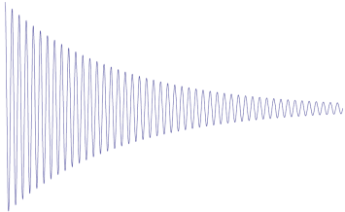








$$π/2$$
$$π$$
$$π/2$$
$$π/2$$
t1
t2
SQ
$$0$$
$$1$$
$$2$$
DQ
$$3$$
τ
G2=2G1
G1
G2

